Slide 1
Shelf Help –A Book Recommender System
Presented by Manvi Ahuja
Bachelor of Computer Applications (BCA)
Session: 2022–2025

Slide 2
01
Introduction

Slide 3
Too many books, too little time?
In a world flooded with books, choosing your next great read can feel like a mini-existential crisis.
Enter Shelf Help — a smart book recommendation system that helps readers discover books they’ll actually enjoy.
No login. No tracking. Just clean, relevant suggestions — powered by machine learning and wrapped in a user-friendly website.

Slide 4
02
Problem Statement

Slide 5
What should I read next?
That’s a question every book lover has asked — and not always found the answer to.
The Problem:
With thousands of titles available online, finding the right book is overwhelming
Existing recommender systems are often:
Tied to big platforms
Dependent on detailed user histories
Not beginner-friendly

Slide 6
03
So What’s Missing?

Slide 7
So What’s Missing?
01
02
03
04
Lightweight
Accessible to any user
Doesn’t need accounts, history, or tracking
Still gives smart, meaningful recommendations

Slide 8
04
Objectives

Slide 9
To build a book recommender system using collaborative & popularity-based filtering
To create a simple, interactive web interface
To use real-world data and apply machine learning techniques
To perform EDA and uncover reading trends

Slide 10
05
What is a Recommendation System?

Slide 11
Examples: - Netflix: suggests shows you might like - Amazon: recommends products you may want to buy - Goodreads: helps find your next book based on ratings They make content discovery faster, easier, and more personalized.
A Recommendation System is a tool that suggests relevant items to users based on preferences or behavior.

Slide 12
06
Types of Recommendation Systems

Slide 13
Popularity-Based
Collaborative Filtering
Content-Based (Future scope)
Recommends trending or most-rated items
Doesn’t require user data
Great for new users
Recommends based on similar users’ preferences
Learns from user-item interactions
“People who liked X also liked Y”
Suggests items similar to those a user liked
Uses item metadata (e.g., genre, author)

Slide 14
07
Dataset Overview

Slide 15
Understanding the data
File | Description
Users | User-ID, Location, Age (some missing)
Books | ISBN, Title, Author, Year, Publisher, Image URLs
Ratings | Book-Rating from 0 to 10 (0 = implicit rating)

Slide 16
(EDA)
Exploratory Data Analysis

Slide 17
Why EDA?
Before diving into the recommendation system, we decided to get to know the data better. It was like dating the dataset before committing to a serious relationship. Here's why we did it:
Validate assumptions – Are users really rating books the way we think?
Guide model design – What's working in the data? What’s not?
Extract insights – We wanted to uncover trends and patterns to make sure our recommendations hit the mark!

Slide 18
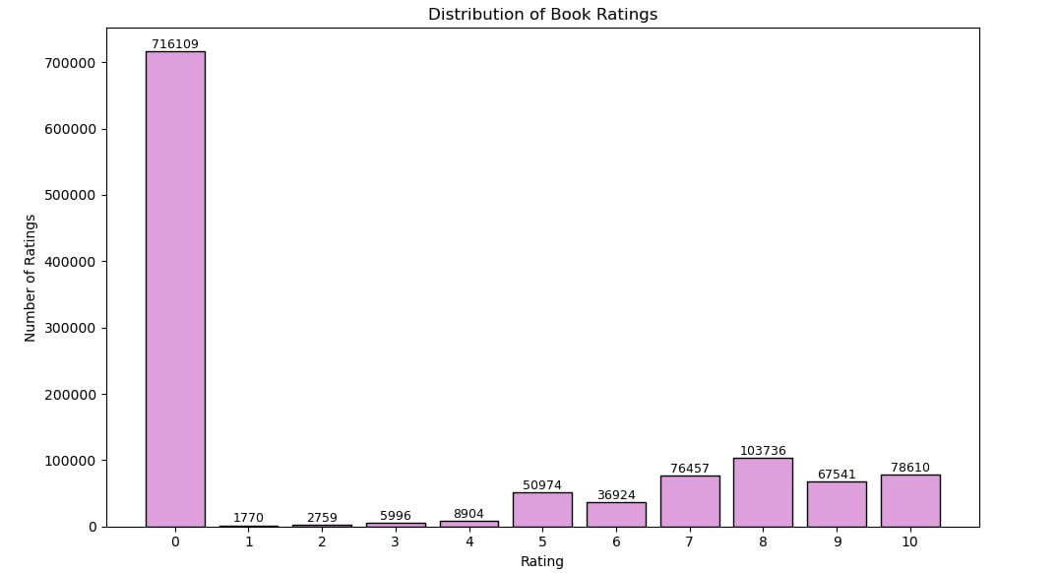
Distribution of Book Ratings

Slide 19
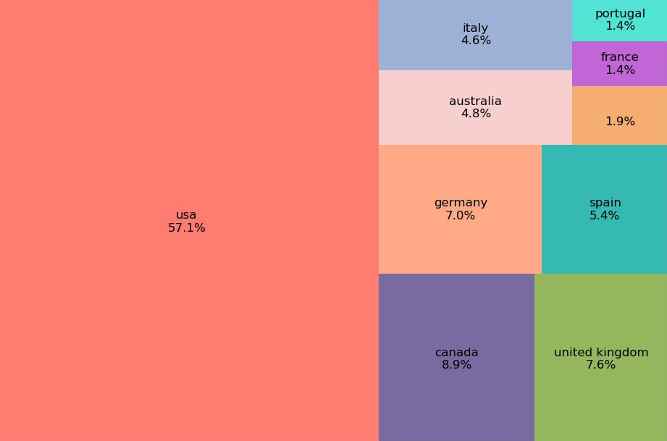
Top 10 Countries by User Count

Slide 20
08
Model Implementation

Slide 21
Shelf Help uses two main approaches:
1. Popularity-Based Filtering
- Recommends books that have:
- High average ratings
- A large number of votes
- Best for new or anonymous users
- Doesn’t rely on past user behavior
Built using simple aggregation of ratings and votes
2. Collaborative Filtering
- Recommends books based on similar readers’ preferences
- Uses a pivot table (users × books) and cosine similarity
- Takes a book name as input and returns 4 similar books

Slide 22
LIVE Demo
Homepage in Action

Slide 23
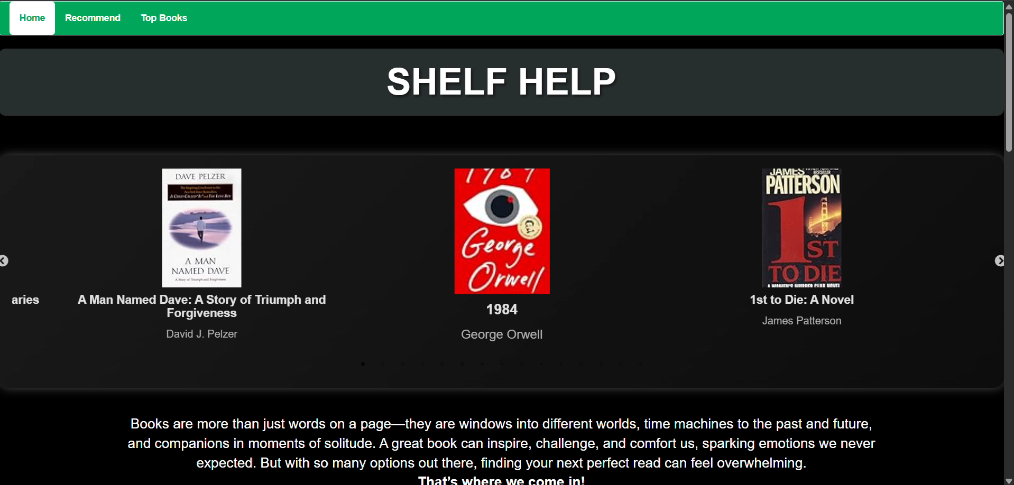
Homepage

Slide 24
09
Output Screens & UI

Slide 25
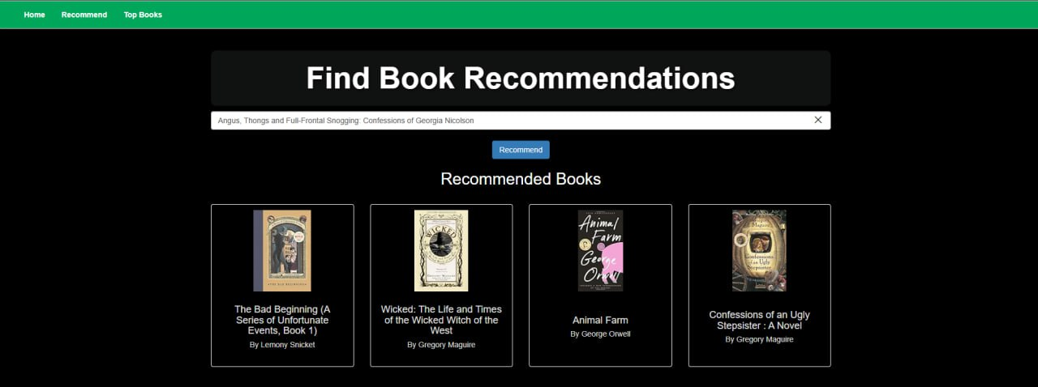
Recommend Page

Slide 26
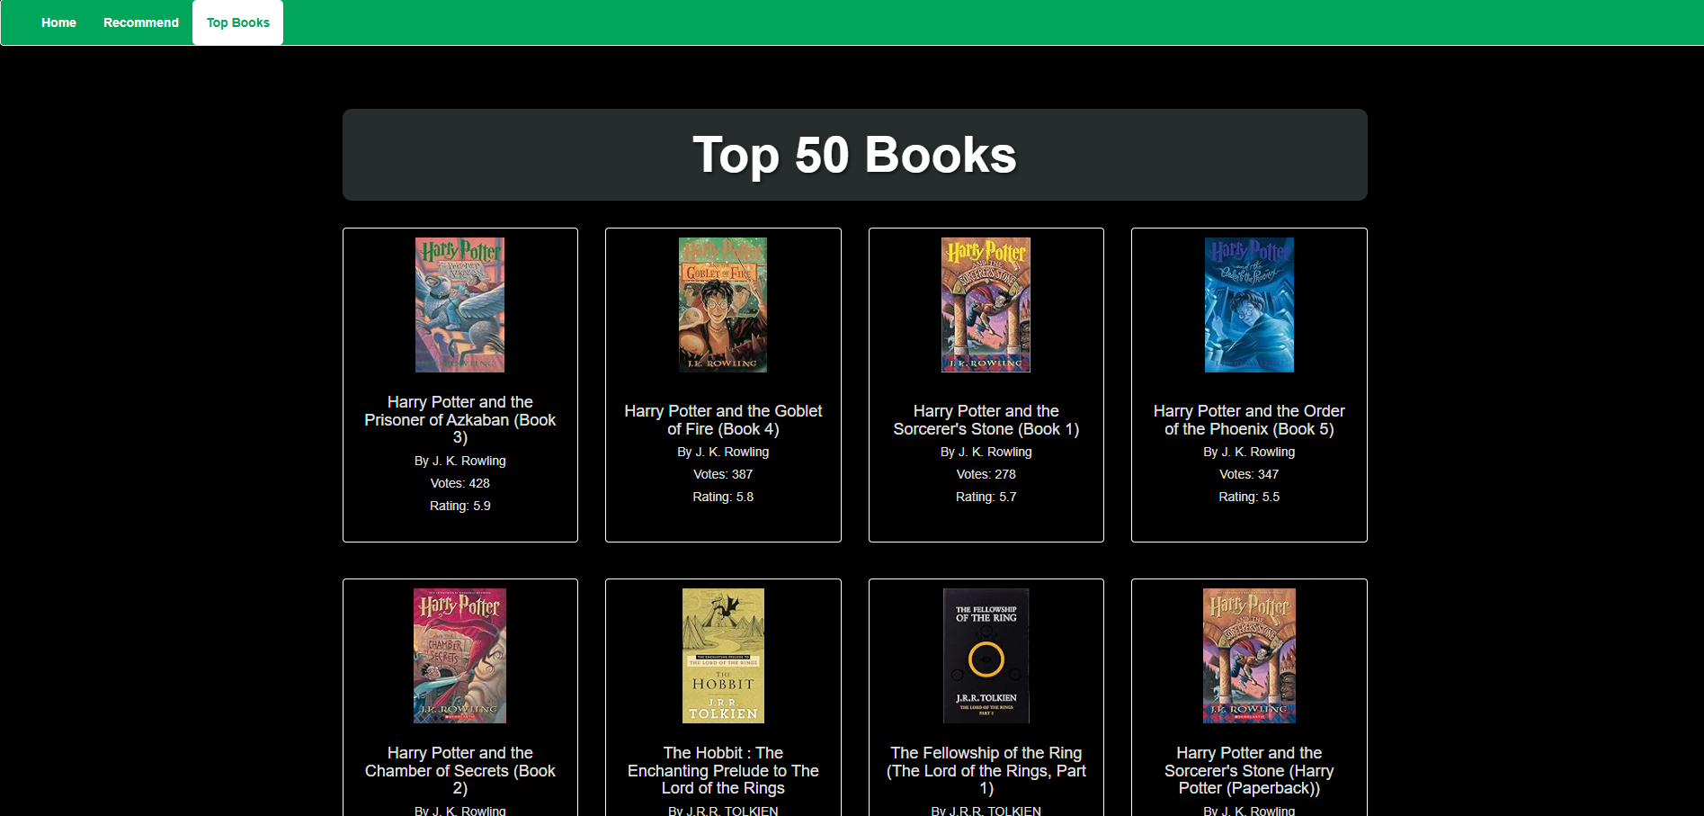
Top Books Page

Slide 27
10
Tech Stack – Behind the Scenes

Slide 28
Component | Tools / Technologies Used
Programming | Python, HTML, CSS, JavaScript
Libraries | Pandas, NumPy, Scikit-learn, Flask, Pickle, Seaborn, Squarify, Matplotlib
IDEs | Jupyter Notebook, VS Code
Version Control | GitHub
Dataset Source | Book-Crossing Dataset (Kaggle)

Slide 29
11
Future Scope

Slide 30
Where Shelf Help Can Go Next:
- User Accounts: Save favorites, track reading history, and get personal recs.
- Content-Based Recs: Use genres and summaries to suggest similar books.
- Multilingual Support: Recommend books in different languages.
- Review Sentiment: Understand how people feel about books through their reviews.
- Reading Lists: Create wishlists and custom book collections.
- More Data: Integrate with APIs like Goodreads for fresher book info.

Slide 31
Conclusions
Shelf Help started with a simple goal:
Make book discovery easier and more fun.
Built two types of recommendation systems
Explored and understood the dataset deeply
Created a working web app to demo it all
This is just the beginning—
because the love for books never stops growing.

Slide 32
Thanks!

